Slide 1
Biological Modeling of Neural Networks
Week 6: Hebbian Learning
6.1 Synaptic Plasticity
- Hebbian Learning
- Short-term Plasticity
- Long-term Plasticity
- Reinforcement Learning
6.2 Models of synaptic plasticity
- Hebbian learning rules
6.3
-
-
6.4
Week 6
Hebbian LEARNING and
ASSOCIATIVE MEMORY
Wulfram Gerstner
EPFL, Lausanne, Switzerland
Notes:
1st lecture:
About 25 minutes until the quiz and a total of 40 minutes until exercise 1. Exercise 1 should be finished at the end of the first lecture.
2nd lecture:
Exercise 1 should be reformulated with explicit: active neuron = 20Hz, inactive neuron = 0 Hz, threshold = 10Hz.
In 2014 Exercise 1 was more general, and students were unable to solve it. So it took me 10 minutes to explain this exercise.
Main topic of week 6: blackboard calculation for stochastic Hopfield (continuation of week 5)
Ideally exercise 2 (energy picture) should be at the end of the second lecture (I dropped it in 2014)
3rd lecture:
Simulations for spiking neurons plus data from Quiroga (Sidney Opera house). This takes 30 minutes. Finished at 11:45

Slide 2
6.1 Synaptic plasticity
pre
post
i
Synapse
j

Slide 3
6.1 Synaptic plasticity: Hebbian Learning
pre j
i
k
post
When an axon of cell j repeatedly or persistently
takes part in firing cell i, then j’s efficiency as one
of the cells firing i is increased
Hebb, 1949
- local rule
- simultaneously active (correlations)

Slide 4
6.1 Synaptic plasticity: Hebbian Learning
Hebbian Learning

Slide 5
6.1 Synaptic plasticity: Hebbian Learning
item memorized

Slide 6
6.1 Synaptic plasticity: Hebbian Learning
Recall:
Partial info
item recalled

Slide 7
6.1 Synaptic plasticity
-Hebbian Learning
- Experiments on synaptic plasticity
-Formulations of Hebbian Learning

Slide 8
6.1 Synaptic plasticity
Hebbian Learning in experiments (schematic)
pre j
u
EPSP
no spike of i
i
post
pre j
Both neurons
simultaneously active
i
post
pre j
EPSP
no spike of i
i
post
Increased amplitude

Slide 9
Classical paradigm of LTP induction – pairing
LTP induction:
tetanus at 100Hz
neuron depolarized
to -40mV
Test stimulus
At 0.1 Hz
neuron at -70mV
Standard LTP
PAIRING experiment
Fig. from Nature Neuroscience 5, 295 - 296 (2002) D. S.F. Ling, … & Todd C. Sacktor
See also: Bliss and Lomo (1973), Artola, Brocher, Singer (1990), Bliss and Collingridge (1993)

Slide 10
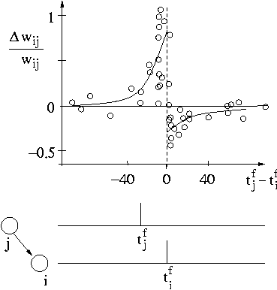
Spike-timing dependent plasticity (STDP)
pre j
60 repetitions
i
Markram et al, 1995,1997
Zhang et al, 1998
review:
Bi and Poo, 2001
post
Pre
before post

Slide 11
6.1 Classification of synaptic changes
-
Induction of changes
- fast (if stimulated appropriately)
- slow (homeostasis)
pre
post
i
j
Persistence of changes
- long (LTP/LTD)
- short (short-term plasticity)
Functionality
- useful for learning a new behavior
- useful for development (wiring for receptive field development)
- useful for activity control in network
- useful for coding

Slide 12
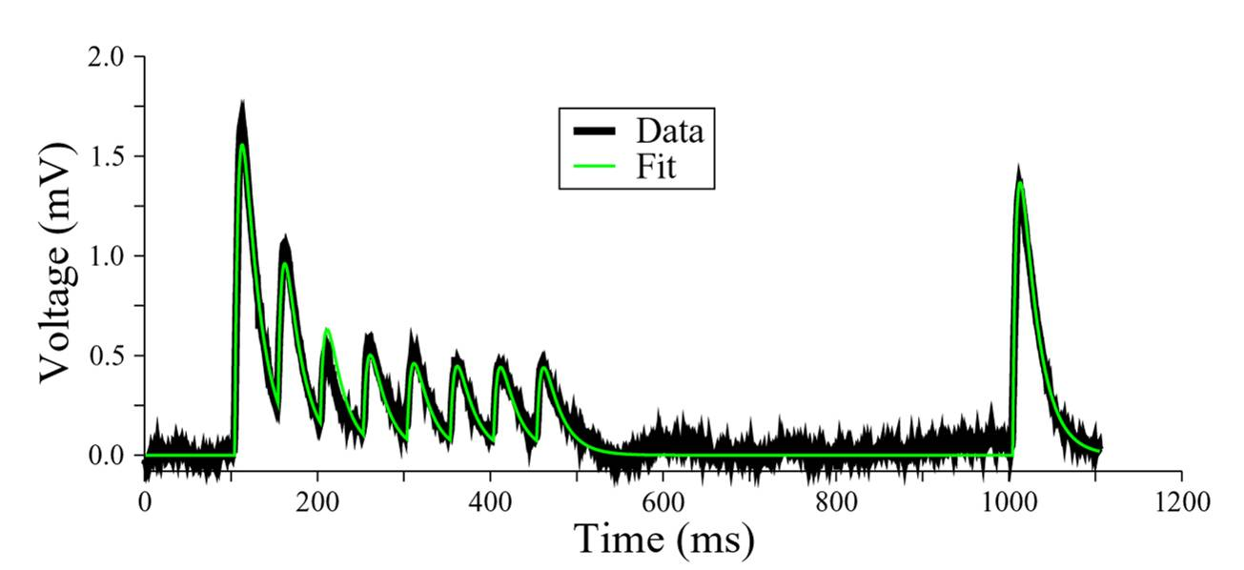
6.1 Classification of synaptic changes: Short-term plasticity
+50ms
20Hz
pre j
post
i
Short-term plasticity/fast synaptic dynamics
Thomson et al. 1993
Markram et al 1998
Tsodyks and Markram 1997
Changes
- induced over 0.5 sec
- recover over 1 sec
Data: Silberberg,Markram
Fit: Richardson (Tsodyks-Markram model)

Slide 13
6.1 Classification of synaptic changes: Long-term plasticity
+50ms
20Hz
pre j
30 min
post
i
Long-term plasticity/changes persist
Changes
- induced over 3 sec
- persist over 1 – 10 hours
(or longer?)

Slide 14
Short-Term vs/ Long-Term
6.1 Classification of synaptic changes
LTP/LTD/Hebb
Changes
- induced over 0.1-0.5 sec
- recover over 1 sec
Changes
- induced over 0.5-5sec
- remains over hours
Protocol
- presynaptic spikes
Protocol
-presynaptic spikes + …
Model
- well established
(Tosdyks, Senn, Markram)
Model
- we will see

Slide 15
6.1 Classification of synaptic changes: unsupervised learning
Hebbian Learning
= unsupervised learning
pre
post
i
j

Slide 16
6.1 Classification of synaptic changes: Reinforcement Learning
SUCCESS
Reinforcement Learning
= reward + Hebb
local global

Slide 17
unsupervised vs reinforcement
6.1 Classification of synaptic changes
LTP/LTD/Hebb
Reinforcement Learning
Theoretical concept
- passive changes
- exploit statistical correlations
Theoretical concept
- conditioned changes
- maximise reward
success
pre
pre
post
i
j
i
j
Functionality
useful for development
( wiring for receptive fields)
Functionality
- useful for learning
a new behavior

Slide 18
Modulated Hebbian Learning
= neuromodulator + Hebb
Neuromodulator: Interestingness, surprise;
attention; novelty
local global

Slide 19
Quiz 6.1: Synaptic Plasticity and Learning Rules
Long-term potentiation
[ ] has an acronym LTP
[ ] takes more than 10 minutes to induce
[ ] lasts more than 30 minutes
[ ] depends on presynaptic activity, but not
on state of postsynaptic neuron
Learning rules
[ ] Hebbian learning depends on
presynaptic activity and on
state of postsynaptic neuron
[ ] Reinforcement learning
depends on neuromodulators
such as dopamine indicating
reward
Short-term potentiation
[ ] has an acronym STP
[ ] takes more than 10 minutes to induce
[ ] lasts more than 30 minutes
[ ] depends on presynaptic activity, but not
on state of postsynaptic neuron

Slide 20
Biological Modeling of Neural Networks
Week 6: Hebbian Learning and Associative Memory
6.1 Synaptic Plasticity
- Hebbian Learning
- Short-term Plasticity
- Long-term Plasticity
- Reinforcement Learning
6.2 Models of synaptic plasticity
- Hebbian learning rules
6.3 Hopfield Model
- probabilistic
- energy landscape
6.4 Attractor memories
Week 6
Hebbian LEARNING and
ASSOCIATIVE MEMORY
Wulfram Gerstner
EPFL, Lausanne, Switzerland

Slide 21
6.2 Hebbian Learning (rate models)
pre j
i
k
post
When an axon of cell j repeatedly or persistently
takes part in firing cell i, then j’s efficiency as one
of the cells firing i is increased
Hebb, 1949
- local rule
- simultaneously active (correlations)
Rate model:
active = high rate = many spikes per second

Slide 22
6.2 Rate-based Hebbian Learning
pre j
i
post
Blackboard
a = a(w_{ij})
a(w_{ij})
w_{ij}

Slide 23
6.2 Rate-based Hebbian Learning
pre j
i
k
post
pre
on
off
on
off
post
on
on
off
off
+
0
0
0

Slide 24
Hebbian Learning
Recall:
Partial info
item recalled

Slide 25
6.2 Rate-based Hebbian Learning
pre j
i
k
post
pre
on
off
on
off
post
on
on
off
off
+
0
0
0
+
-
-
-
+
0
-
0
+
-
-
+

Slide 26
Exercise 1 now: learning of prototypes
Prototype
p¹
Prototype
p²
interactions
(1)
Sum over all prototypes
a) Show that (1) corresponds to a rate learning rule
(2)
Next lecture
10:15
Assume that weights are zero at the beginning;
Each pattern is presented (enforced) during 0.5 sec (One after the other).
note that but
b) Compare with:
c) Is this unsupervised learning?
Notes:
Landed here at 9:55
Ideal would be to land here at 9:50

Slide 27
The end

